Slide 1
Arkansas Research Center’s
Unified Discretionary Grants
Data System
Initial Training
Presented by:
Jake Walker, PhD, Project Manager
&
Nathan Gray, Programmer/Developer
Notes:
_____________________________________________________________________
_____________________________________________________________________
_____________________________________________________________________
_____________________________________________________________________
_____________________________________________________________________
_____________________________________________________________________
_____________________________________________________________________
_____________________________________________________________________
_____________________________________________________________________
_____________________________________________________________________
_____________________________________________________________________

Slide 2
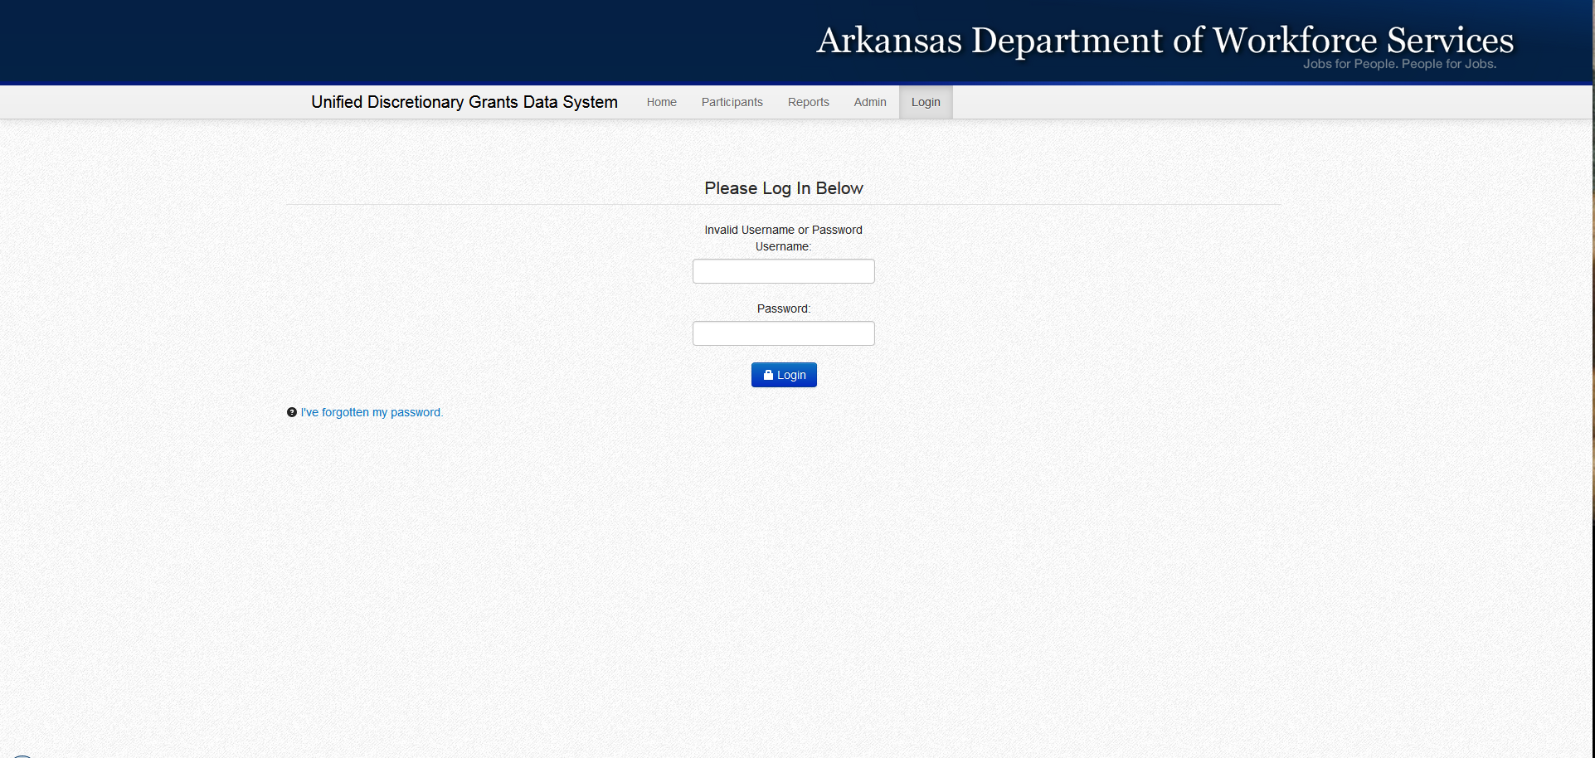
Login
Website= arc.arkansas.gov/udgs
Username= Institution Abbreviation
Password= welcome1
Once we have all case managers by institution we will assign each a unique Username and Password.
Notes:
_____________________________________________________________________
_____________________________________________________________________
_____________________________________________________________________
_____________________________________________________________________
_____________________________________________________________________
_____________________________________________________________________
_____________________________________________________________________
_____________________________________________________________________
_____________________________________________________________________
_____________________________________________________________________
_____________________________________________________________________

Slide 3
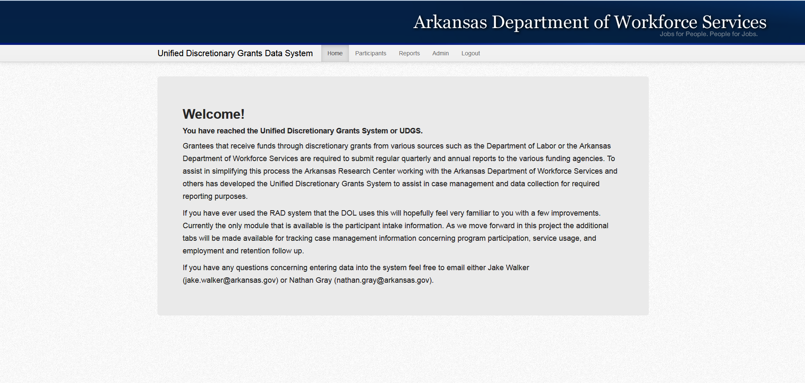
Home
Once you have logged in you will be taken to this screen. From here you can access your participants, reports, and any administrative functions you have available to you.
****Currently the Participants tab is the only one that is functional. The others will be made available as they are completed.****
Notes:
_____________________________________________________________________
_____________________________________________________________________
_____________________________________________________________________
_____________________________________________________________________
_____________________________________________________________________
_____________________________________________________________________
_____________________________________________________________________
_____________________________________________________________________
_____________________________________________________________________
_____________________________________________________________________
_____________________________________________________________________

Slide 4
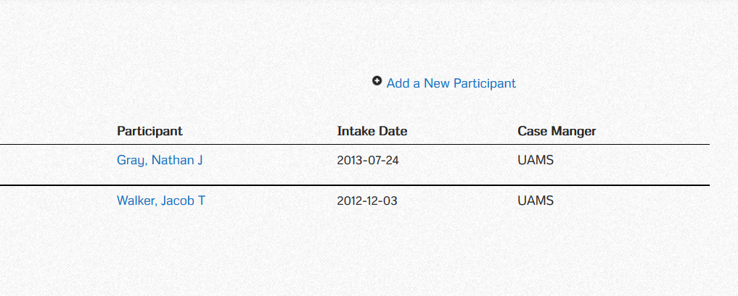
Participants
If you have entered participants this screen will populate with the participants’ information currently assigned to you. From here you can access and manage their information as needed by clicking on their name.
If you have not entered any participants yet into the system you can do so by clicking on the Add a New Participant link in the upper right hand corner of the screen. This will take you to the intake form where you can enter their initial demographic information.
Notes:
_____________________________________________________________________
_____________________________________________________________________
_____________________________________________________________________
_____________________________________________________________________
_____________________________________________________________________
_____________________________________________________________________
_____________________________________________________________________
_____________________________________________________________________
_____________________________________________________________________
_____________________________________________________________________
_____________________________________________________________________

Slide 5
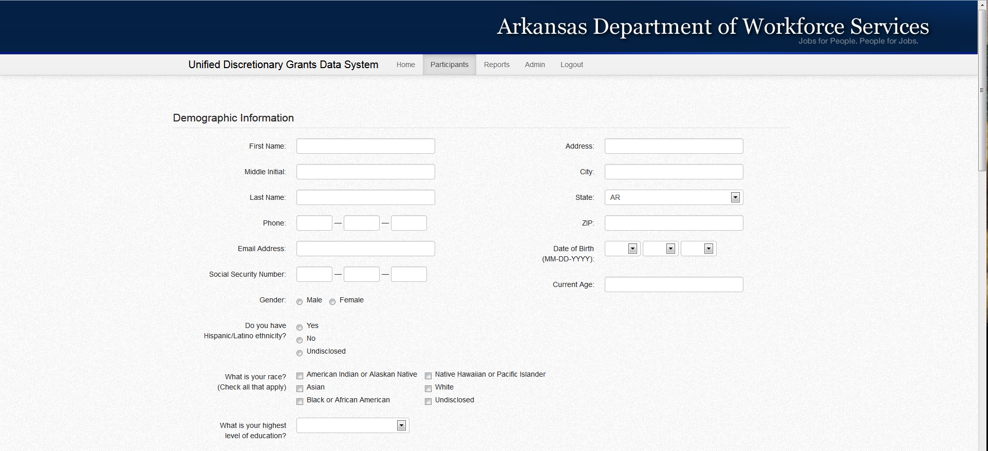
Demographics/Intake
Once you click to add a participant you will be taken to this screen where you will enter their demographics and any information from the initial intake form.
As you answer certain questions other questions will become available as they relate to specific areas. Examples will be shown in the following slides.
Also some questions have been modified slightly due to data collection requirements of HUB so pay close attention to questions .
Notes:
_____________________________________________________________________
_____________________________________________________________________
_____________________________________________________________________
_____________________________________________________________________
_____________________________________________________________________
_____________________________________________________________________
_____________________________________________________________________
_____________________________________________________________________
_____________________________________________________________________
_____________________________________________________________________
_____________________________________________________________________

Slide 6
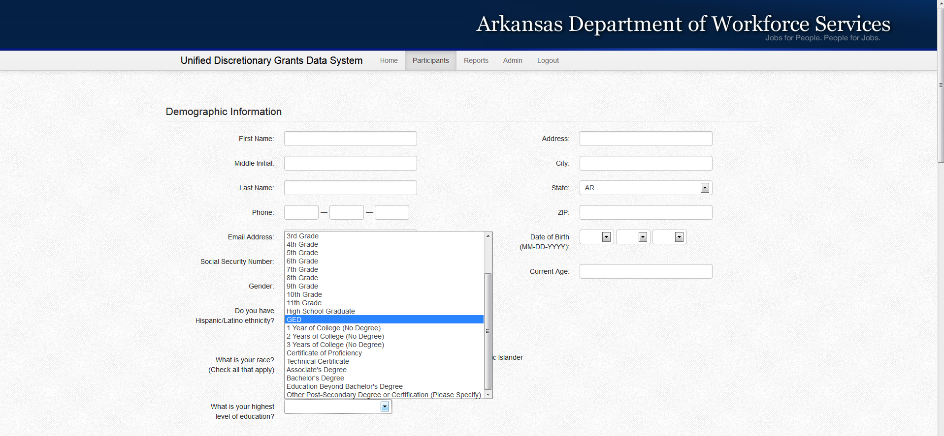
Level of Education
Highest Level of Education is one of the questions where the answers have changed to comply with HUB data requirements.
On the new intake form you will see where the categories have changed a little but are pretty much the same except for the answers of Less than High School Graduate requires a Last Grade Completed, and Some College No Degree requires the Number of Years Completed.
Notes:
_____________________________________________________________________
_____________________________________________________________________
_____________________________________________________________________
_____________________________________________________________________
_____________________________________________________________________
_____________________________________________________________________
_____________________________________________________________________
_____________________________________________________________________
_____________________________________________________________________
_____________________________________________________________________
_____________________________________________________________________

Slide 7
Level of Education
Original Intake Form 7-25-12 | New Intake Form 6-25-13
Less than High School Graduate or Equivalent (GED) | Less than High School Graduate
 | Last Grade Completed
If you have the original intake form, and if you know the last grade completed enter it here if not just enter 11. If you have the new intake form use the year the respondent reported on the intake form on the online form.
High School Graduate or Equivalent (GED) | High School Graduate
 | GED
If you have the original intake form, and you know if the person graduated from high school or got their GED make the distinction here. If you have the original intake form and do not know and they selected High School Graduate or Equivalent select High School Graduate.
1 to 4 years or More of College, or Full-Time Technical or Vocational School | Some College No Degree
 | Number of Years Completed
If you have the original intake form and know how many years they completed of college with no degree select it here. If you do not know how many years they completed or if they completed more than 3 years just select 3 Years of College (No Degree).
 | Certificate of Proficiency
 | Technical Certificate
These options will only apply if you have the new intake form.
Associate's Degree | Associate's Degree
Bachelor's Degree | Bachelor's Degree
Advanced Degree | Advanced Degree or Certificate
 | Other
Mark as indicated on the intake form.
Notes:
_____________________________________________________________________
_____________________________________________________________________
_____________________________________________________________________
_____________________________________________________________________
_____________________________________________________________________
_____________________________________________________________________
_____________________________________________________________________
_____________________________________________________________________
_____________________________________________________________________
_____________________________________________________________________
_____________________________________________________________________

Slide 8
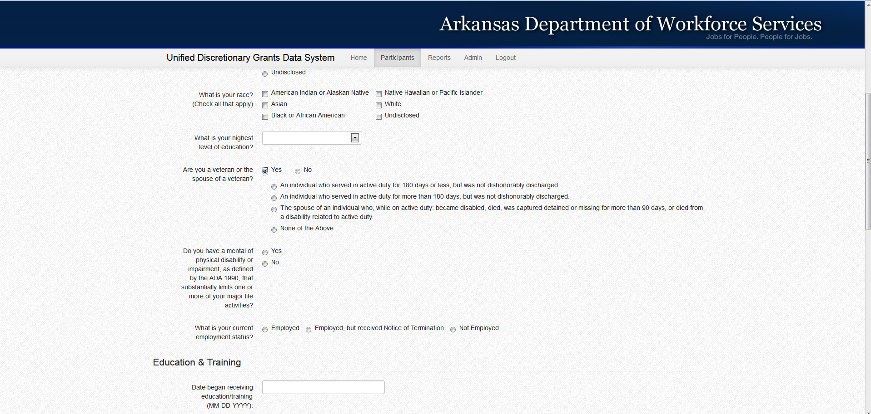
Veteran Status
If the participant is not a veteran or the spouse of a veteran select no, if they are a veteran or spouse of a veteran select yes and then select one of the first three options that apply if they are an eligible veteran. If none of the first three options apply select the fourth option of None of the Above to indicate that while they may be a veteran, they are not an eligible veteran as defined by the requirements of this grant.
****To be classified as an eligible veteran they must meet one of the first three options listed.****
If you did not collect information pertaining to whether they meet the definition of eligible veteran, you will need to do so, and return at a later date and update the intake form.
Notes:
_____________________________________________________________________
_____________________________________________________________________
_____________________________________________________________________
_____________________________________________________________________
_____________________________________________________________________
_____________________________________________________________________
_____________________________________________________________________
_____________________________________________________________________
_____________________________________________________________________
_____________________________________________________________________
_____________________________________________________________________

Slide 9
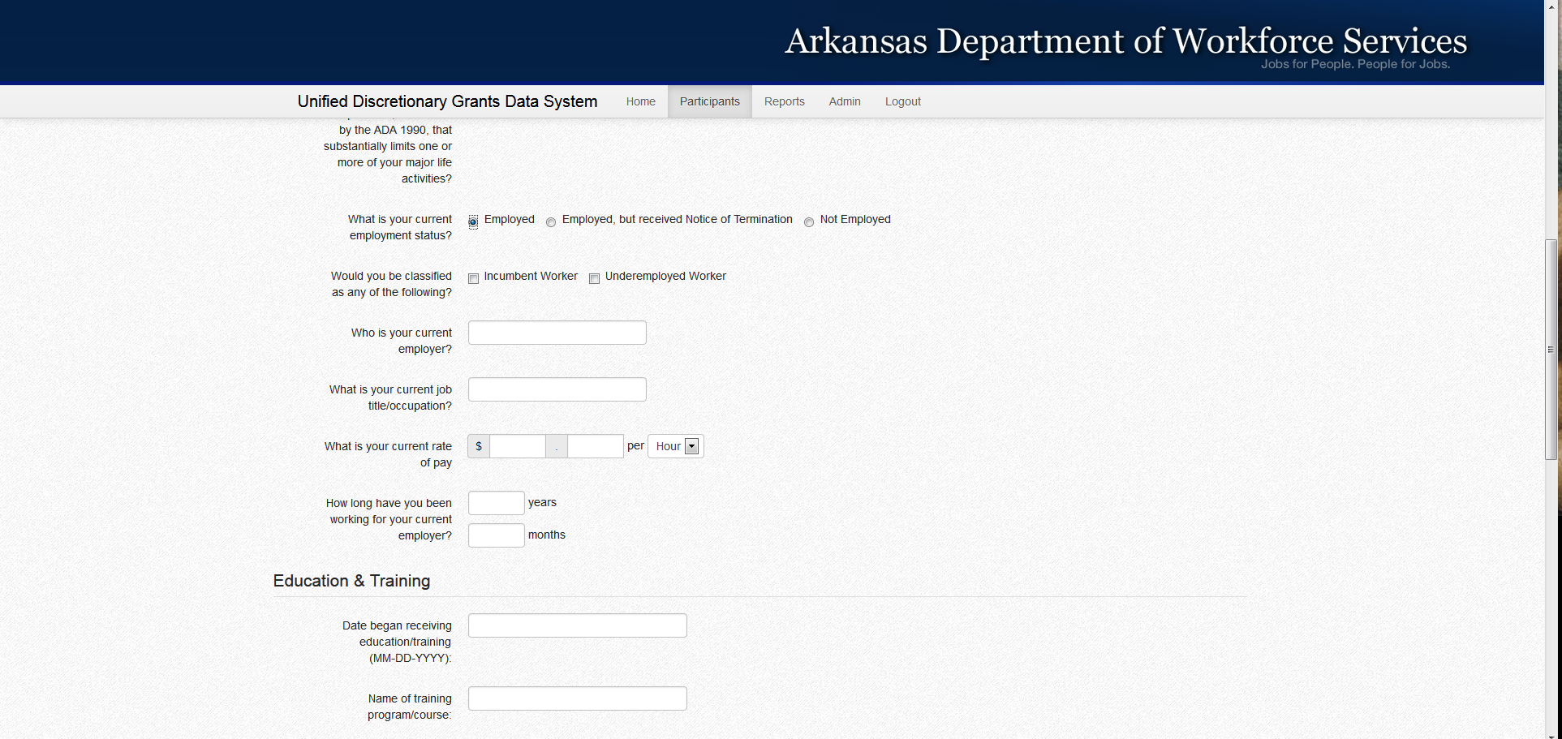
Employment Status=Employed
For each of the employment statuses there will be a series of additional questions that were not on the original intake form that are on the new intake form and are needed for proper reporting to the HUB.
If they are employed you will need to indicate what type of worker they are, their current employer, job title, length of time with their current employer, and wages either per hour or per year. It is preferable you get wages per hour if possible.
Notes:
_____________________________________________________________________
_____________________________________________________________________
_____________________________________________________________________
_____________________________________________________________________
_____________________________________________________________________
_____________________________________________________________________
_____________________________________________________________________
_____________________________________________________________________
_____________________________________________________________________
_____________________________________________________________________
_____________________________________________________________________

Slide 10
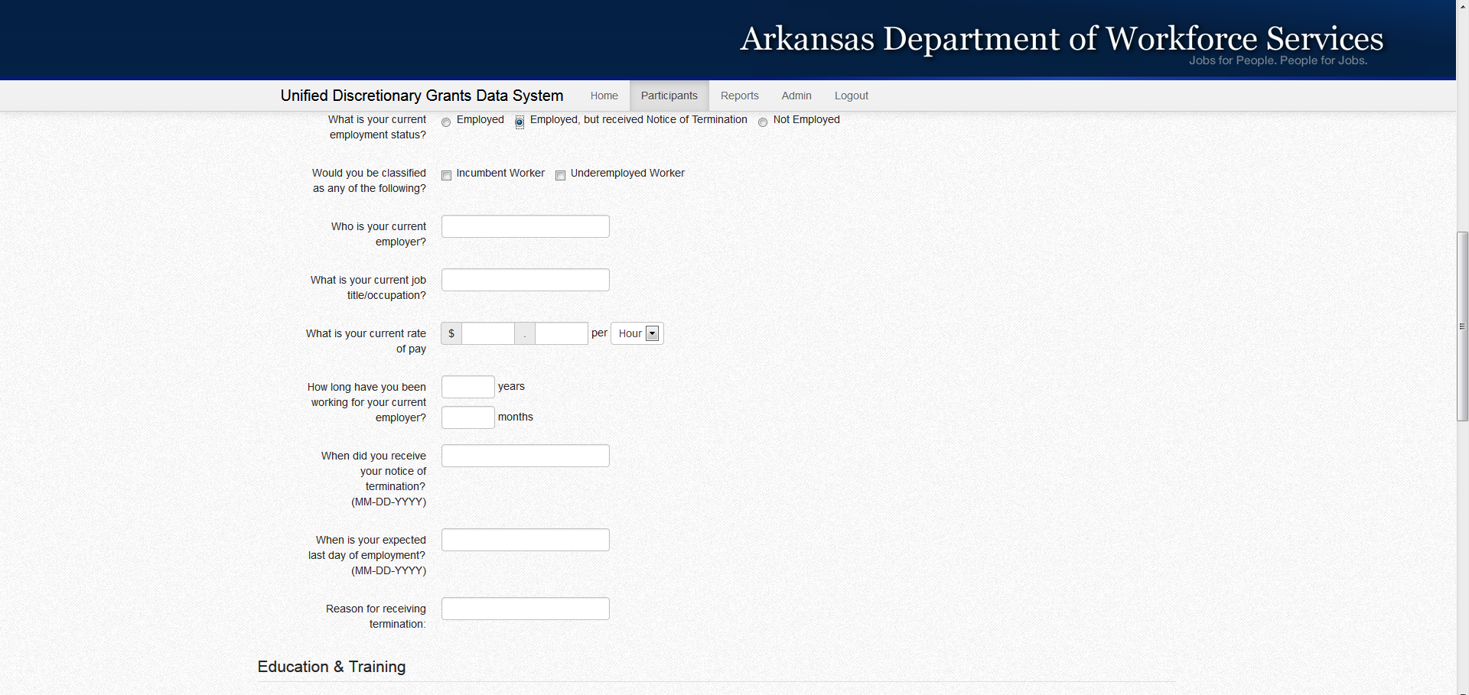
Employment Status= Employed, but Received Notice of Termination
If they are employed, but received notice of termination, you will enter all the same information as if they were employed with the addition of the date when they received notice of termination, their expected last date of employment, and reason for termination.
Notes:
_____________________________________________________________________
_____________________________________________________________________
_____________________________________________________________________
_____________________________________________________________________
_____________________________________________________________________
_____________________________________________________________________
_____________________________________________________________________
_____________________________________________________________________
_____________________________________________________________________
_____________________________________________________________________
_____________________________________________________________________

Slide 11
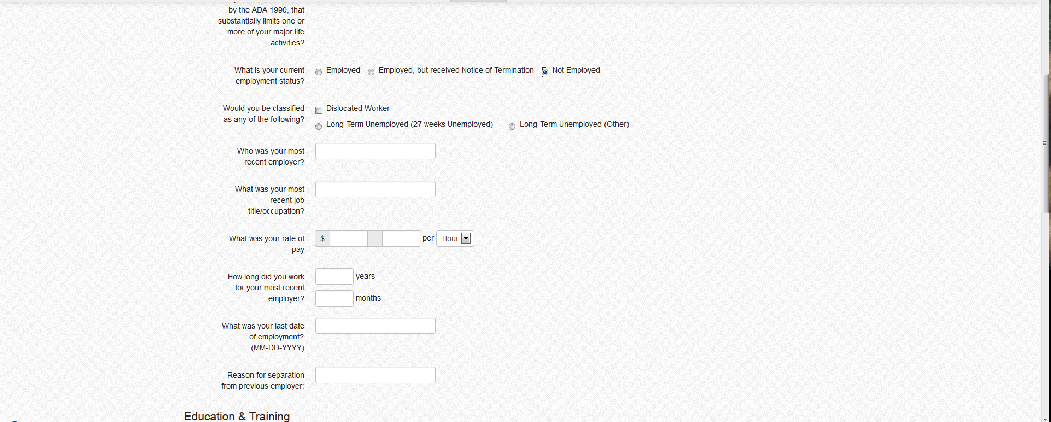
Employment Status= Not Employed/Unemployed
If they are unemployed, collect the information as it pertains to the individual’s most recent employer. If you or the client needs clarification on the differences between Long Term Unemployed (27 weeks Unemployed) and Long Term Unemployed (Other) or any other terms referenced on this form you can see the list of definitions on the last page of the new intake form dated 06-25-2013.
Notes:
_____________________________________________________________________
_____________________________________________________________________
_____________________________________________________________________
_____________________________________________________________________
_____________________________________________________________________
_____________________________________________________________________
_____________________________________________________________________
_____________________________________________________________________
_____________________________________________________________________
_____________________________________________________________________
_____________________________________________________________________

Slide 12
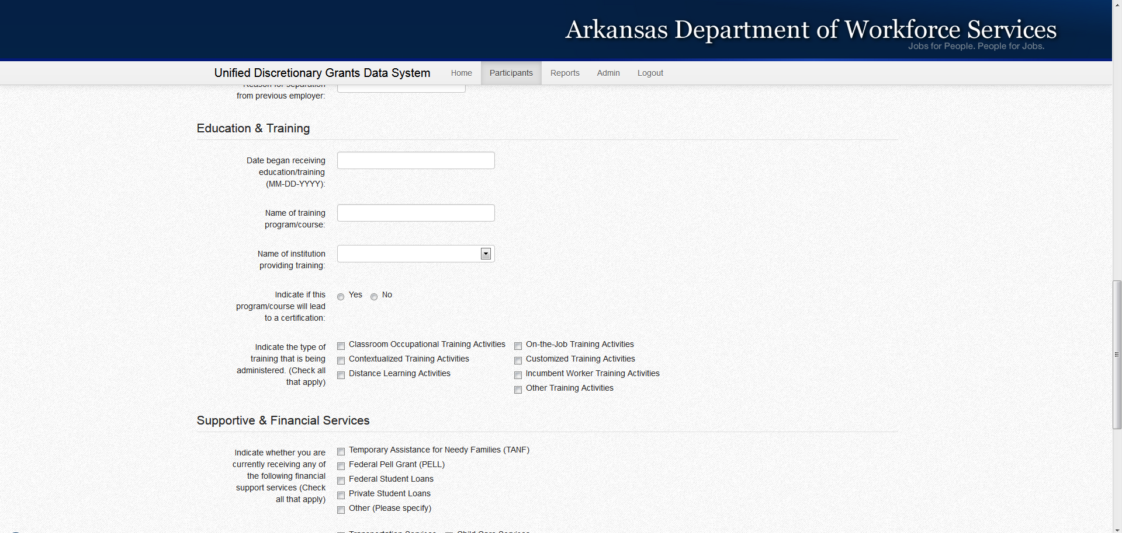
Education and Training
In this section you will enter the basic information related to the education/training program that the participants enroll in at your institution. This information will populate into the Program Tab for the participant.
The types of training that are being administered will need to be selected here but will also need to be added under the Education and Training Tab as education/training activities.
Notes:
_____________________________________________________________________
_____________________________________________________________________
_____________________________________________________________________
_____________________________________________________________________
_____________________________________________________________________
_____________________________________________________________________
_____________________________________________________________________
_____________________________________________________________________
_____________________________________________________________________
_____________________________________________________________________
_____________________________________________________________________

Slide 13
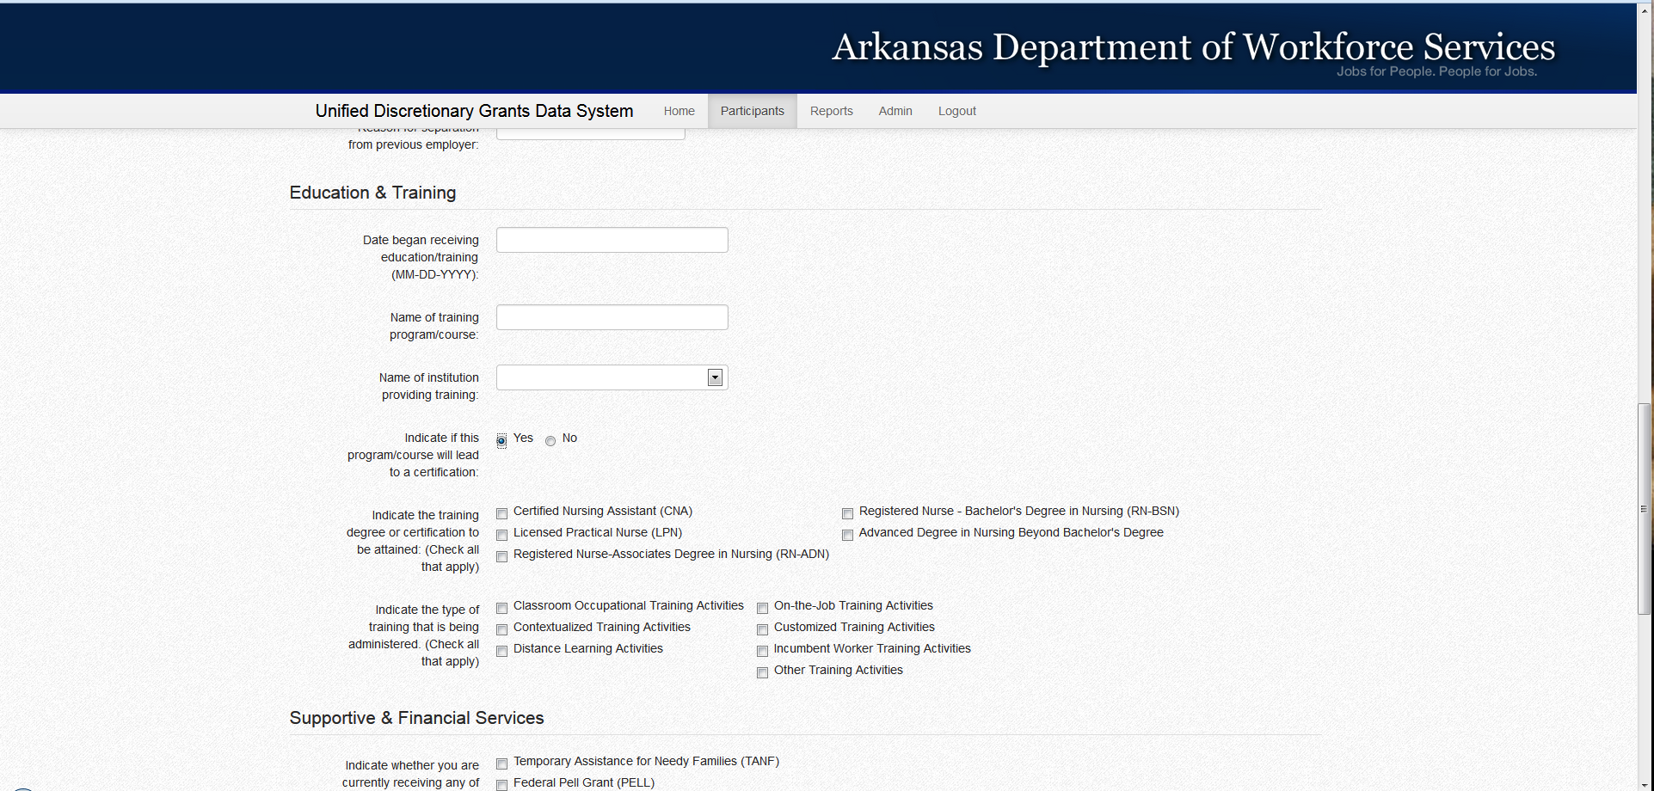
Education and Training
Once you select if the program will lead to a degree or certification the list of available degree or certification options will become available.
If a person will be earning multiple degrees or certifications while in the program select all that will apply.
Notes:
_____________________________________________________________________
_____________________________________________________________________
_____________________________________________________________________
_____________________________________________________________________
_____________________________________________________________________
_____________________________________________________________________
_____________________________________________________________________
_____________________________________________________________________
_____________________________________________________________________
_____________________________________________________________________
_____________________________________________________________________

Slide 14
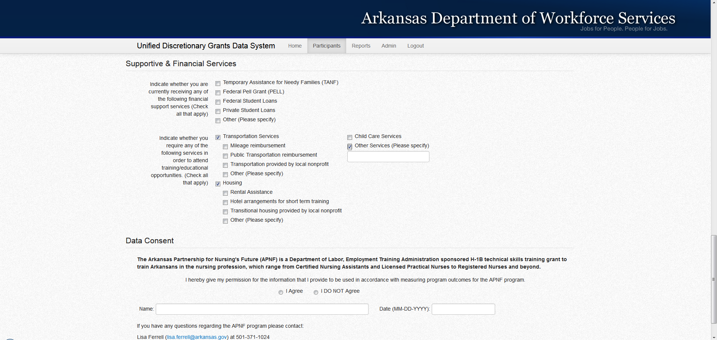
Supportive and Financial Services
In this section you will enter any type of financial assistance the participant is receiving, as well as if the participant will require additional services related to transportation, housing, and child care services. Once you select the type of services needed a more detailed list will populate.
The selections made here will populate into the Other Services Tab and can be accessed from the Participant Summary screen once you save the intake information.
Notes:
_____________________________________________________________________
_____________________________________________________________________
_____________________________________________________________________
_____________________________________________________________________
_____________________________________________________________________
_____________________________________________________________________
_____________________________________________________________________
_____________________________________________________________________
_____________________________________________________________________
_____________________________________________________________________
_____________________________________________________________________

Slide 15
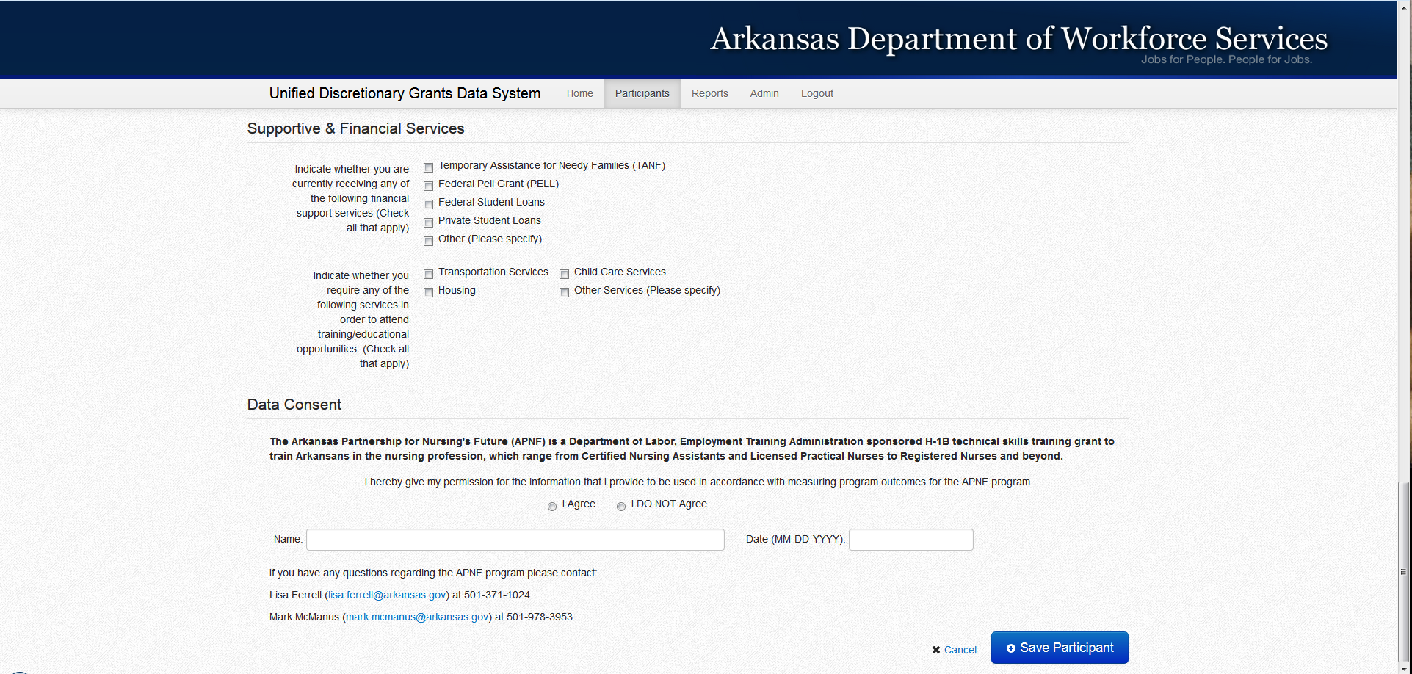
Data Consent
For the data consent type the participants name and the date they signed your original intake form.
Once you have entered all the information from the intake form click the Save Participant button.
Notes:
_____________________________________________________________________
_____________________________________________________________________
_____________________________________________________________________
_____________________________________________________________________
_____________________________________________________________________
_____________________________________________________________________
_____________________________________________________________________
_____________________________________________________________________
_____________________________________________________________________
_____________________________________________________________________
_____________________________________________________________________

Slide 16
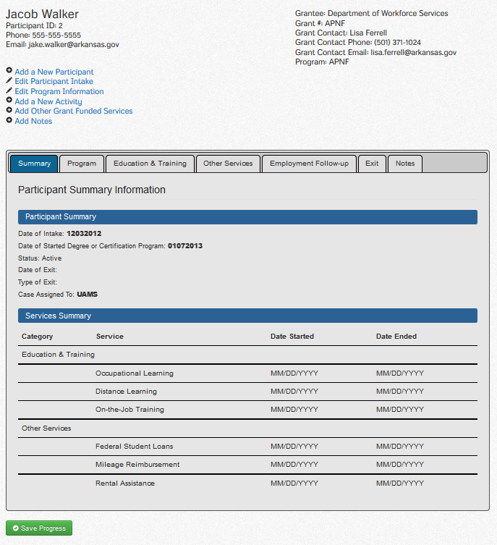
PARTICIPANT SERVICES TAB
From here you can navigate to the areas that need additional information. You will notice it is partially prepopulated with data from the intake form. For example, you will notice that the Services Summary contains information on Educational Services but there are no dates associated with them. You will need to click on the Education and Training Tab to enter the start dates for the various educational and training activities.
Notes:
_____________________________________________________________________
_____________________________________________________________________
_____________________________________________________________________
_____________________________________________________________________
_____________________________________________________________________
_____________________________________________________________________
_____________________________________________________________________
_____________________________________________________________________
_____________________________________________________________________
_____________________________________________________________________
_____________________________________________________________________

Slide 17
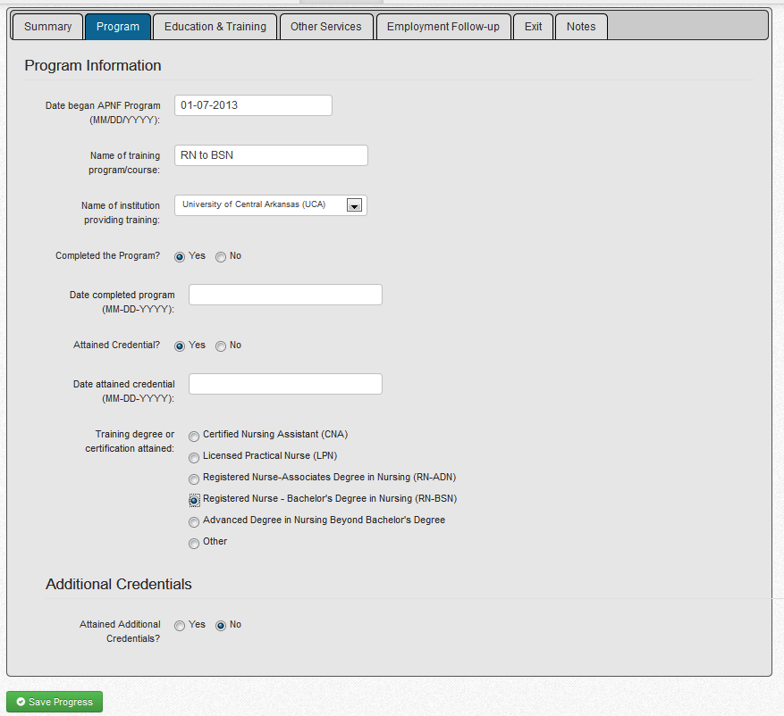
Program Tab
Information from the intake form will populate here concerning the first three items.
Additional information pertaining to program completion and credential attainment will have to be entered manually by the case manager once they have occurred.
Once they have completed the program and you have proof of completion and credential attainment, you will enter that information here.
Notes:
_____________________________________________________________________
_____________________________________________________________________
_____________________________________________________________________
_____________________________________________________________________
_____________________________________________________________________
_____________________________________________________________________
_____________________________________________________________________
_____________________________________________________________________
_____________________________________________________________________
_____________________________________________________________________
_____________________________________________________________________

Slide 18
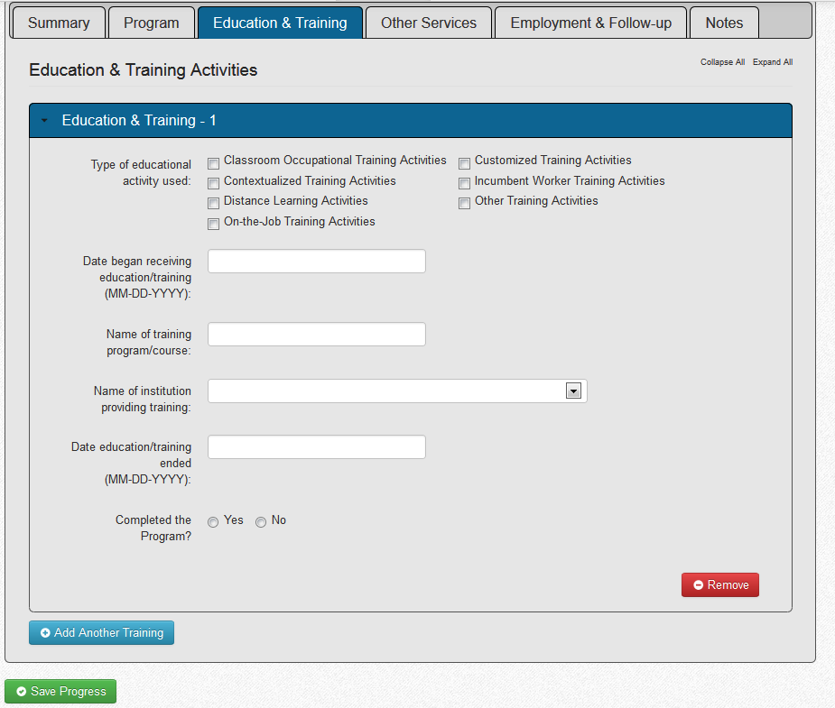
Education and Training Tab
There will be one Education & Training Activity/Service record for each of the ones selected on the intake form. You will need to enter the additional information concerning each activity/service.
Once you have completed entering the information on the first service click the Save Button.
If you need to enter more than 1 activity/service click the Add Another Training Button.
If you need to remove an activity that is incorrect you will use the Remove Button.
Notes:
_____________________________________________________________________
_____________________________________________________________________
_____________________________________________________________________
_____________________________________________________________________
_____________________________________________________________________
_____________________________________________________________________
_____________________________________________________________________
_____________________________________________________________________
_____________________________________________________________________
_____________________________________________________________________
_____________________________________________________________________

Slide 19
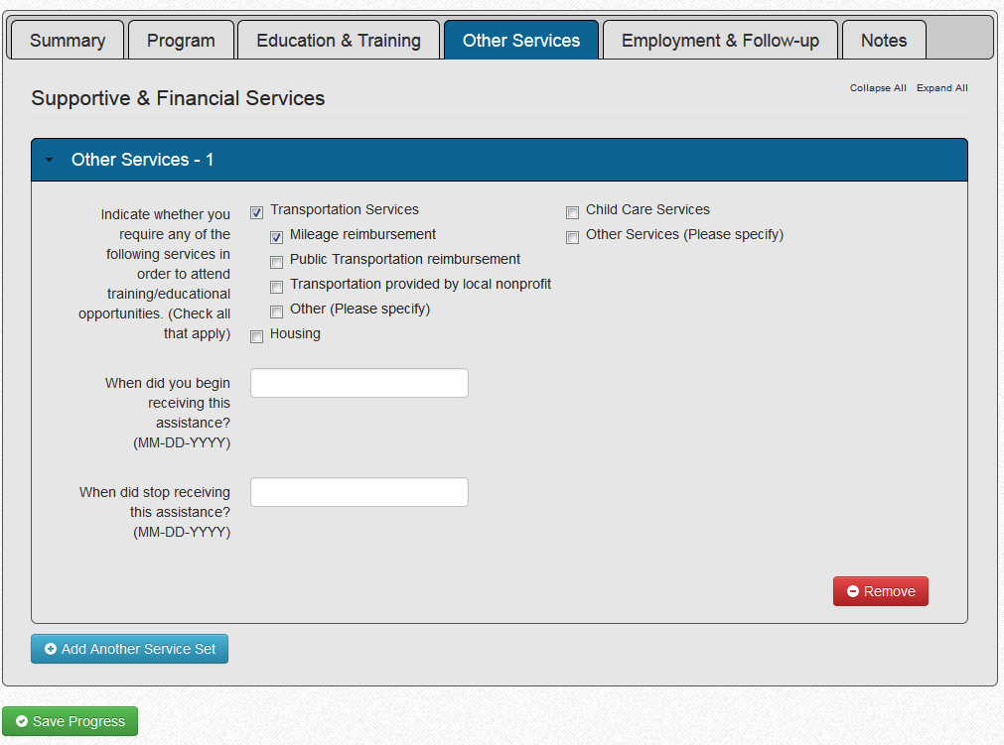
OTHER SERVICES TAB
Like with the Education and Training Tab on the Other Services Tab you will have to enter one service type at a time saving between them and clicking on the Add Another Services Button.
Remember to Save regularly, and if you need to remove the service click he Remove Button.
Notes:
_____________________________________________________________________
_____________________________________________________________________
_____________________________________________________________________
_____________________________________________________________________
_____________________________________________________________________
_____________________________________________________________________
_____________________________________________________________________
_____________________________________________________________________
_____________________________________________________________________
_____________________________________________________________________
_____________________________________________________________________

Slide 20
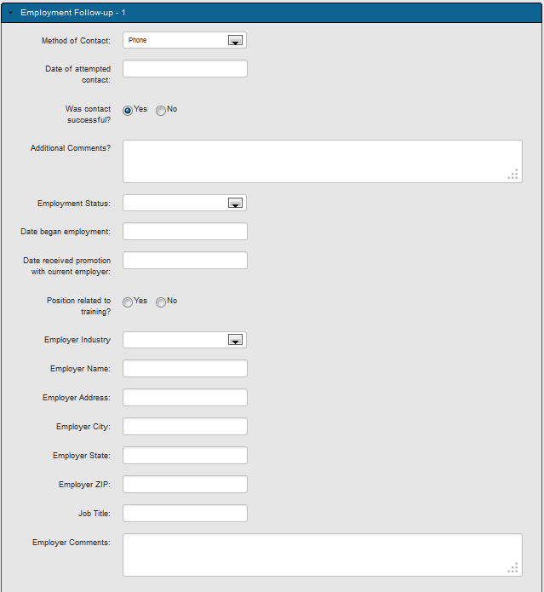
EMPLOYMENT AND FOLLOW-UP TAB
Notes:
_____________________________________________________________________
_____________________________________________________________________
_____________________________________________________________________
_____________________________________________________________________
_____________________________________________________________________
_____________________________________________________________________
_____________________________________________________________________
_____________________________________________________________________
_____________________________________________________________________
_____________________________________________________________________
_____________________________________________________________________

Slide 21
questions
?
Notes:
_____________________________________________________________________
_____________________________________________________________________
_____________________________________________________________________
_____________________________________________________________________
_____________________________________________________________________
_____________________________________________________________________
_____________________________________________________________________
_____________________________________________________________________
_____________________________________________________________________
_____________________________________________________________________
_____________________________________________________________________

Slide 22
Contacts
DWS
  Lisa Ferrell (lisa.ferrell@arkansas.gov)
    501-371-1024
  Mark McManus (mark.mcmanus@arkansas.gov)
    501-978-3953
ARC
  Jake Walker (jake.walker@arkansas.gov)
    501-852-0107
  Nathan Gray (nathan.gray@arkansas.gov)
Notes:
_____________________________________________________________________
_____________________________________________________________________
_____________________________________________________________________
_____________________________________________________________________
_____________________________________________________________________
_____________________________________________________________________
_____________________________________________________________________
_____________________________________________________________________
_____________________________________________________________________
_____________________________________________________________________
_____________________________________________________________________

